Slide 1


Introduction to R-INLA
With minimal equations!
Download the following tutorials from
https://github.com/LKUA/EEID
template_BU.csv
linear model in inla.Rmd
poisson mixed effect model.Rmd
Setting priors.Rmd
spatial dependency.Rmd
Notes:
Has everyone got R studio?
Open the markdown documents in Rstudio (if familiar with github fork the repository otherwise just download the tutorials
For those not familiar with R markdown documents, you write code within the r chunks and comment using the hashtag as per normal. Outside the R chunks can write any comments etc.

Slide 2
Outline for the session
Hour 1: a bit of theory
What is spatial dependency and why do we care?
How do we capture it?
Brief introduction to Bayesian theory
Bayesian computing approaches
Hour 2: Using INLA – theory and practical
Explore different distributions
Add dependency – hierarchical
Adjusting priors
Hour 3: Spatial heterogeneity in INLA
Including spatial heterogeneity – theory
Including spatial heterogeneity – practice
Extracting results from model
Predicting from the model

Slide 3
What is spatial dependency
Why should we care?
Toblers first law of geography: “Everything is related to everything else, but near things are more related than distant things” - 1969
Notes:
Toblers first law of geography: Everything is related to everything else
Pseudoreplication
Lack of independence
Two types: Spatial autocorrelation – what occurs at that location is related to
The conditions of that variable at nearby locations
The conditions of other variables at that location
S

Slide 4
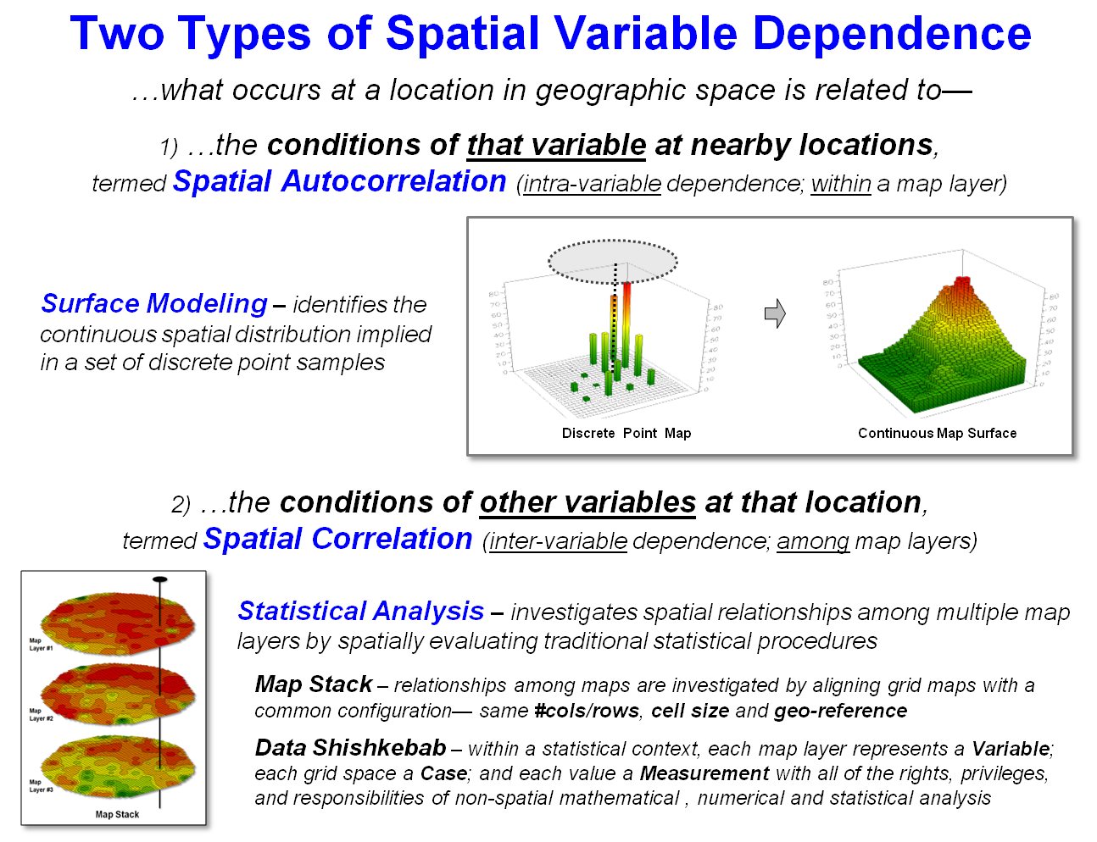
Spatial dependency
Two main types:
Spatial autocorrelation
What occurs at that location is related to the condition of that variable at nearby locations
Spatial correlation
What occurs at that location is related to the condition of other variables at that location
Notes:
Two types: Spatial autocorrelation – what occurs at that location is related to
The conditions of that variable at nearby locations
The conditions of other variables at that location
Interested in the second one but need to deal with the first one
Normally can account for by using mixed effects models BUT
Doesn’t explicitly model the spatial aspect
Spatial aspect may contain important information

Slide 5
How to capture spatial autocorrelation (in R)?
Can do using gls – but this limits both how you capture the spatial heterogeneity AND how complex / appropriate the models can be
Matérn correlation – more freedom to describe the shape of the correlation function (and more meaningful)
Used by INLA, not by other packages which can handle spatial autocorrelation
So, to do it you need to go Bayesian!
IF YOU WANT TO KNOW MORE – Zuur, Silveniev and Ieno 2017; Highland Statistics course, Blangiardo and Cameletti (2015)

Slide 6
Probability
Objective vs. subjective
If you repeat a trial a large number of times, you get a probability.
That probability is associated with that object → Objective
Frequentist
Need to know the occurrence of the event in entire population – don’t normally know this
If you already have an idea about the outcome, then you use that to define your probability → Subjective
Eg betting: Don’t bet on something if you think it is going to lose.
Probability is therefore the rate at which an individual is willing to bet on the occurrence of an event
Changes with the individual.
Notes:
Eg dice roll – roll loads of times, probability is 1/6 you get a 6 and doesn’t change. Probabiility is defined by the object

Slide 7
Conditional probability
Given two events (A and B), we ca define the conditional event as A|B
Probability of event A given B has already happened
Probability of B is calculated before we observe A, then the probability of observing A given B is used to update the original B
Finally the probability of B given A can be calculated
BACKBONE OF THE BAYESIAN ANALYSIS

Slide 8
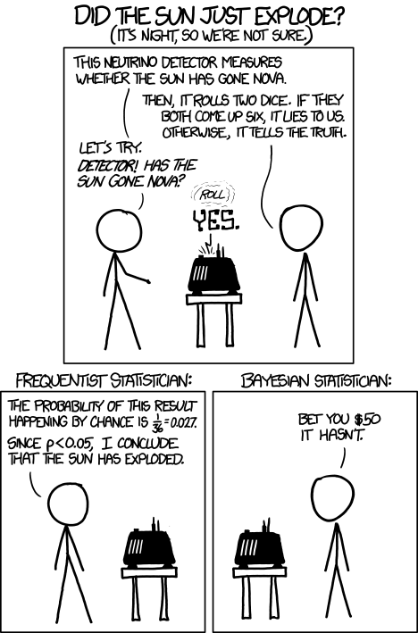
Frequentist vs Bayesian
The approach:
In Bayesian look at the probability of a parameter given the data.
Frequentist look at the probability of the data, given a parameter.
Incorporate prior belief
Good as if you have prior knowledge, why not use it?
Bad because no longer objective
Credible / Confidence intervals
Bayesian: There is a 95% probability that our parameter is between x1 and x2
Frequentist: If we repeated the experiment a large number of times, our parameter would not be outside of our interval less than 5% of the time
Estimating the parameter:
In Bayesian get a distribution (so a range of values for the parameter) given the data, and can access that distribution, and often take the mean to be the value for the parameter (plus the credible intervals).
In frequentist we assume there is one value for parameter.
Notes:
Go Bayesian so you can incorporate prior belief. This is good because if you have prior knowledge, you should use it.
Can be bad because seen as no longer objective
Frequentist – interpretation of confidence intervals and non repeatability of experiments.
Bayesian: There is a 95% probability that our parameter is between x1 and x2
Frequentist: If we repeated the experiment a large number of times, our parameter would not be outside of our interval less than 5% of the time
Key difference: In Bayesian look at the probability of a parameter given the data. Frequentist look at the probability of the data, given a parameter.
In Bayesian get a distribution (so a range of values for the parameter) given the data, and can access that distribution, and often take the mean to be the value for the parameter (plus the credible intervals). In frequentist we assume there is one value for parameter.

Slide 9
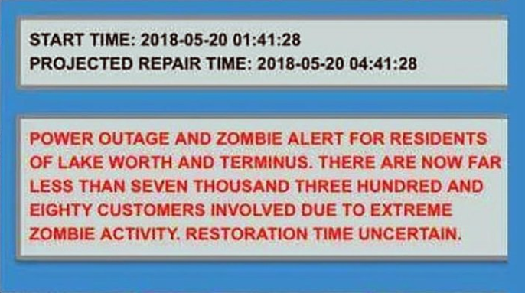

Zombie Bayesian example
Notes:
Lake Worth Florida Zombie attack

Slide 10
In Lake Worth, if zombies are coming,
we want to know how quickly infection will spread
People look healthy for a while, so we want to test them to see if they are infected before they show it
We have a test that is 99% efficient in both directions – if someone is positive they will test positive 99% of the time and vice versa
Bob is tested and he is positive. What are the chances that he has the disease?

Slide 11
99% chance seems intuitive…
To calculate: We need the efficacy (99%) and lets assume that half our population is infected – its midway through the pandemic
To do the numbers, we will assume a total population of 2000
Seems like our assumption of 99% was correct
 | + | - | Total
Infected | 990 | 10 | 1000
Healthy | 10 | 990 | 1000
Total | 1,000 | 1,000 | 2000

Slide 12
We assumed that our initial ratio was 50/50. What if we change that?
At the beginning of the epidemic maybe only 10% of people were infected. How good is our test then?
Good news for Bob! His chances have improved!
Of the 216 that tested positive, only 198 are infected (198/216 *100 = 0.92) so now, our test that detects 99% of cases is only 92% effective.
Intuitive answer ignores the fact that 1% of the healthy population tests positive
As the healthy population grows compared to the infected population, that 1% begins to overwhelm the ones who are infected and test positive.
 | + | - | Total
Infected | 198 | 2 | 200
Healthy | 18 | 1782 | 1800
Total | 216 | 1784 | 2000
Notes:
Key factor here is that we have some knowledge about our population, and including that changes our result = we have a condition that we want to take account of

Slide 13
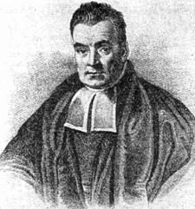
Reverend Thomas Bayes: 1701-1761
Notes:
Conditional probability!

Slide 14
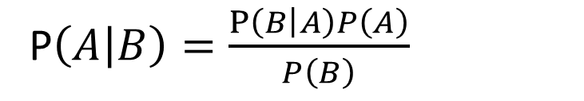
Bayes theorem
Described the formula for how probabilities interact
P(A) = probability of being infected
P(B) = probability that any individual in the population will test positive (in this case this will be the probability of a positive test occurring in the population for an infected person PLUS the probability of a positive test occurring in the population for a healthy person)
P(A|B) = probability of being infected if you test positive
P(B|A) = Probability you will test positive given you are infected
P$\left(\left.A\right|B\right)=\frac{P\left(\left.B\right|A\right)P\left(A\right)}{P\left(B\right)}$

Slide 15
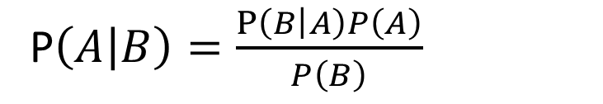
P$\left(\left.A\right|B\right)=\frac{P\left(\left.B\right|A\right)P\left(A\right)}{P\left(B\right)}$
50% infected:
P(Infected|TestPositive) = (P(TestPositive|Infected)*P(Infected)/P(TestPositive)
P(Infected|Positive)=(0.99*0.5)/((0.99*0.5)+(0.01*0.5)) = 0.495/0.5 =0.99
What if one in 10000 people are infected?
P(Infected|Positive)=(0.99*0.00001)/((0.99*0.00001)+(0.01*0.9999)) = 0.0098
Notes:
Here we were able to use our prior knowledge about the efficacy of the test (and a guess about the infection rate in the population)
Can update your model as more information comes to light

Slide 16
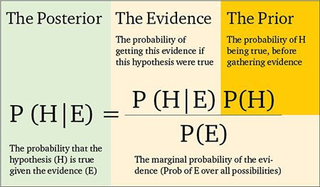
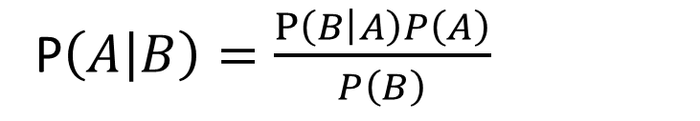

More on Bayesian analysis - inference
P$\left(\left.A\right|B\right)=\frac{P\left(\left.B\right|A\right)P\left(A\right)}{P\left(B\right)}$
$$P\left(\left.B\right|A\right)∝P\left(\left.A\right|B\right)P\left(B\right)$$
Probability of the data, given parameter beta = probability of beta given the data * probability of the data /probability of beta
We want the probability of beta given the data (this is our posterior distribution) so rearrange the formula
In practice can not know P(data) so P(beta|data) is proportional to P(data|beta)*P(beta)
Choose likelihood of the data (expected distribution), prior for regression parameter (beta), can calculate posterior distribution
Can use these rules (extended) with any distribution from the exponential family
If distribution is discrete – can use mathematics to calculate the mean, if continuous then use integrals.
If you want to know more – references at the end of the presentation
Notes:
Bayesian approaches for observable events well established. More controversial is its use in statistical analysis where parameters are unknown quantities and their prior dirtibution needs to be specified in orde to obtain the coresponsing posterior distribution.
Called inference – fundamental distribction between observable and unknown quantities
Means if we choose the likelihood of the data (ie the expected distribution) and a suitable prior for the regression parameter (ie an expected distribution of values we think the parameter could take) we can calculate the posterior distribution. Some can be done by hand (so called conjugal prior and likelihoods) but usually need to resolve this analytically
Conjugal priors are the rare cases where the posterior distribution belongs to the same family as the prior distribution. As the functional form of the posterior distribution is known, it is therefore simple to extract summary statistics. THIS IS RARE in practice – conjugacy is broken if you want to specify a generalised regression model

Slide 17

Key features of a Bayesian analysis
$$P\left(\left.B\right|A\right)∝P\left(\left.A\right|B\right)P\left(B\right)$$
Posterior distribution of parameter, given the data
P(data|B) – likelihood of the data given the parameters.
P(B) – Prior information about the parameter
Notes:
Posterior distribution of parameter, given the data
Prime interest – What we want. Usually the mean and the credible intervals (analogous to the estimate and the standard errors of a frequentist analysis)
P(data|B) – likelihood of the data given the parameters.
Assign that a distribution (eg. for count data use Poisson / Neg Binom; continuous use Gamma or Normal, bounded 0-1 use binomial , presence absence use Bernoulli) = the bit you do in the family = bit of a glm
P(B) – Prior information about the parameter
This is vital as represents the information available for parameters of interest (eg the effect of a parameter in a glm – do we expect it to have a positive or a negative impact? By how much?)
Should always include a sensitivity analysis of priors to see how it impacts your results
For the prior you have A) The distribution (which reflects the nature of the parameter) and the hyperparameters which make the distribution more or less informative
Usually a natural candidate eg. if you have a proportion you want a distribution that is bounded between 0 and 1
What you use depends on the parameter of interest
E.g. height of people – if you had already done a study on this, you could include mean and variance from that study. The smaller the variance in this example, the more precise the prior and the more influence it will have on the data. If by chance you measured a basketball team as your first sample, and were convinced that that was a representative sample then it could influence your resultant posterior distribution. However, if after measuring said basketball team, you then went out and measured another random sample, and came up with a different solution, you can update your knowledge with this information through the prior

Slide 18




Lets talk priors
WE KNOW NOTHING! Use a diffuse prior.
WE KNOW SOMETHING! Use an informative prior
In a regression analysis: We put priors on all the regression parameters describing our prior belief about the direction (slope) of the relationship
If the regression parameters can be positive or negative then use diffuse normal priors
Priors for standard deviations NEED TO ALWAYS BE POSITIVE. Normal distribution is therefore not a good choice.
Use e.g. uniform or gamma which are bounded positive
$$β\sim N\left(μ,σ^{2}\right)$$
$$β\sim N\left(0,{1000}^{2}\right)$$
$$β\sim N\left(μ,σ^{2}\right)$$
$$β\sim N\left(0,{0.1}^{2}\right)$$
Notes:
Choice of prior distribution important as it represents the information available to for the arameters of interest.
Need
B ~N(0,1000) = the mean of beta is zero but it could be a lot less or a lot more
In effect – we don’t really know much about the importance of this parameter
Want to chose the variance (sigma2) to ensure that the normal distribution covers the likely values with high probability
Similar result to frequentist analysis
Eg. restrict the variance of the prior
More informative the prior, the stronger its effect on the data
Therefore an informative prior will “drag” the posterior distribution towards itself

Slide 19
So now we know a bit about the basics behind Bayesian approaches….
How do we use them in practice?

Slide 20
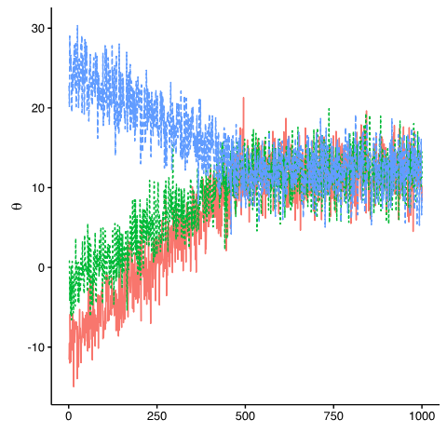
Simulation based methods (eg MCMC)
Conjugate vs non conjugate priors
Majority of cases involve priors and likelihoods from different distributions, which are non conjugate
Therefore, solving analytically is not possible.
Instead, use simulation
MCMC approach
draw correlated chain of samples which approximate the
posterior distribution
Sample for long enough and you should converge on an
approximation of the posterior distribution
Flexible for model building
Slow, computationally unfeasible for large samples
Notes:
For non conjugate models, need a way of solving the integrals when is not possible analytically.
For this, use simulation based approaches (those commonly seen in JAGS or BUGS) (if you want to know the mathematics behind this I can recommend Marta book). Use simulations to generate values from a given density function. As you sample more and more, you converge on the correct distribution Become computationally expensive
Utilises the strong law of large numbers that with enough simulations you converge on the posterior distribution. So to do this, just need to be abele to simulate independent values from a given distribution
Use Markov chain monte carlo (MCMC) approach by drawing a correlated chain of samples of values which approximate the posterior distribution.
The stationary distribution of the MCMC chains are used to calculate the posterior mean and quantiles
Stationary means that the marginal distribution no longer changes over time
Use multiple chains with different initial values to ensure that the chains explore parameter space effectively and that convergence is achieved.
INCLUDE PLOT OF SUCCESFULL CHAINS VS SHIT CHAINS
End up with an approximation of the posterior distribution
Good to use simulations to assess whether your model can return estimates that are similar to your parameters you simulated the data with
Very flexible – can code your own models
Problem: Super super slow, particularly if you have high levels of correlation in the chain. Need to run longer and thin more which becomes computationally infeasible

Slide 21
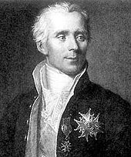
Pierre-Simon Laplace and INLA
Discovered the Laplace transformation
An integral transform
Means can approximate integrals using a deterministic rather than simulation based approach
Lots of maths – if you are interested in the theory check out Blangiardo and Cameletti (2015)
INLA uses laplace approximation to solve integrals and resolve relationships in regressions in a Bayesian framework
1749-1827

Slide 22


R-INLA – integrated nested laplace approximations
Parameters
$$ρ(A)=β1+Xβ2+ε$$
$$ε\sim N\left(μ,σ^{2}\right)$$
Hyperparameter (depends on the distribution of the data)
The joint probability for all the parameters as
the likelihood of the data given all the parameters * prior for the betas given the hyper parameters * prior for the hyperparameter
THIS JOINT DISTRIBUTION IS A GAUSSIAN MARKOV RANDOM FIELD when we assume that the priors of the betas are multivariate normal and independent
But we want the marginal distributions for each of the parameters so need to extract that from R-INLA
As distributions are continuous, need to use integrals to obtain the marginal distributions = where Laplace approximation comes in.
Notes:
B1 and B2 are parameters, sigma2 is a hyperparameter
Hyperparameters are eg. variance from the residual noise term (sigma), dispersion for a negbinom glm, variance parameters of random effects, parameters from spatial correlation function
Nb in the above example the prior specification needs to differ: Beta can take any form where as sigma has to be positive
THIS JOINT DISTRIBUTION IS THE GAUSSIAN MARKOV RANDOM FIELD when we assume that the priors of the betas are multivariate normal and independent which simplifies the calculations

Slide 23
To summarise
We don’t have adequate, easy to use frequentist approaches to accounting for spatial dependency in regression
But we need to account for it
Bayesian approaches give us the means to do so by use of a mathematical trick – treating spatial field as individual random effects and using integrated laplace approximation to determine the posterior distribution
Does this by assuming a normal, multivariate distribution for the priors of our regression parameters, our betas.
We can change the priors depending on our knowledge about the system in question

Slide 24
Linear model – using the BU data
Move to the first tutorial – linear model in R-INLA
We will discuss
Setting INLA up
Extracting fitted values
Extracting summaries
Plotting predictions

Slide 25
Adding dependency

Slide 26
Adding dependency
Can control for dependency in the dataset in a few different ways
All of them involve using random effect structure
HIERARCHICAL – using a random grouping structure aka mixed effects model
TIME – use a random effect that adequately represents time eg. seasonal / random walk / AR1
SPACE – use a spatial random effect (matern correlation) to describe spatial associations

Slide 27
Including random effects
Adding dependency to RINLA is through the f(X, model = “”) command
Check the R INLA website for the different model types (but the documentation is dense)
http://www.r-inla.org/models/latent-models
Remember – random effects come with a variance prior, which is a hyperparameter

Slide 28
Run through the code for the mixed effect model here for BU
We will discuss:
Setting up a poisson model
Including dependency through random effects
Running a negative binomial model
Running a binomial model

Slide 29
Back to the theory

Slide 30
R inla and priors
R inla has default priors. For fixed distribution this is N(0,0.001) (prec = 0.001)
This means we expect B to be somewhere around zero, potentially between -94.8 to +94.8 – DIFFUSE PRIOR
For intercept, precision is 0, which means sigma is large.
Compare to LM
Change priors so is not diffuse – say we have information that for a 1 unit change in population, the BU reduced with a slope -0.65 and a standard error 0.02
Therefore Betapop ~ N(-.65,0.02^2)
Need to convert sigma2 into precision: Taupop = 1/sigma2pop = 1/0.02^2
As need to use tau in inla

Slide 31
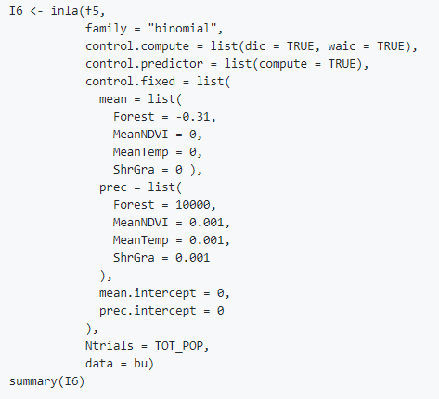
Coding priors in R-INLA 1
For the betas
Always done through the control.fixed option (to change priors for fixed parameters)
Need to use the list option, and include all the variables including the ones remaining as the default
You can change all the priors for the fixed parameters to the same thing, or use list to set different priors

Slide 32
Hyperparameters and dependency
Remember – hyperparameters are the sigmas
This model has two sigmas – one for the residuals (the one we are used to seeing) and one for the random intercept (our dummy grouping)
Prior distributions for hyperparameters can only be positive. Cannot use the normal distribution
Therefore uniform or gamma distribution may be appropriate
IF THERE IS AN ERROR IT IS PROBABLY HYPERPARAMETERS

Slide 33
Changing hyperparameters
For sigma for the normal distribution of the response variable, the prior is set via the control.family argument in the INLA function
For the dependency, set within the f() function
For inla you need to specify a prior distribution for the log of the precision
So…sigma2 is converted to tau by taking the inverse and INLA then uses a log gamma distribution for the priors of log(tau) and log(taudependency)
With a shape parameter a = 1 and an inverse scale parameter b = 0.00005
Extensive simulation study did find that a gamma(1,0.5) is better than gamma(1, 0.00005) that INLA uses so maybe worth changing to that

Slide 34
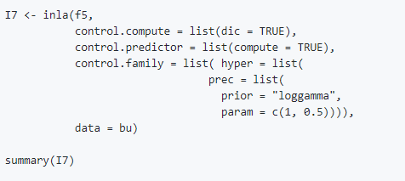
Changing hyperparameters

Slide 35
Run through the code for changing the priors
We will discuss:
Changing priors for the betas
Changing hyperparameters

Slide 36
Including spatial dependency

Slide 37
Spatial dependency
Clearly, using a hierarchical term is not good for our data because 1. I just made it up. And 2. there is likely to be spatial autocorrelation that may not be explained by our covariates (for example, land use is associated with BU)
Instead, want to include correlated spatial random effects
We do this using the Matérn Correlation
If you want to know how this works – the books or the Zuur course are highly recommended (necessary to get the most out of INLA). Especially if you have spatiotemporally correlated data which we wont touch on
All I will say – to get the spatial term for geostatistical data, you need to estimate two Matérn correlation hyperparameters (ws and us).
So in a model you end up with regression parameters beta, two Matérn correlation hyperparameters and a sigma (hyper parameters) and one sigma (hyperparameter) for the residuals

Slide 38
Two types of spatial dependency
Areal dependency
We aren’t going to cover that here but it is available in references at the end (and less complicated than using point data)
Uses a neighbourhood approach

Slide 39

Geostatistical data
Matérn correlation roughly states that the correlation between two points is equal to parameter kappa * by the distance between the sites * mathematical function reliant on kappa and distance (besselk function).
Therefore if you know kappa you can calculate this.
The larger kappa is the smaller the distance at which dependency occurs.
Kappa is basically like thinking about how far you think correlation is important over

Slide 40
Matérn function continued
Covariance is calculated by multiplying correlation by a variance parameter which is our sigma for the spatial correlation
Using a full covariance matrix is too large – that is where the SPDE comes in, to simplify the equations. This is the gaussian markovian random field
GMRF needs to be defined on a regular grid. But geospatial data is rarely regular so need to use a mesh

Slide 41

Meshes
A mesh basically means dividing the study area into a large number of non overlapping triangles that have one common corner
Three corners = vertices
Vertices are initially placed at the sampling locations
Additional vertices defined by the user
Maximum edge length
Defining the mesh:
Avoid: Big and small triangles next to each other (want to be balanced otherwise influence of vertices differs)

Slide 42
Update inla about the random field
Need to tell INLA where the sampling locations are with respect to the mesh
Done using a projector matrix A– this defines weighting factors
Which produces a sparse matrix of 1, 0 and . Which correspond to where the sampling locations are in relation to the grid
Can visualise this to show the residual spatial pattern
Options – Can also put the sampling location inside the triangle – use a non convex hull for bounding

Slide 43
Defining the SPDE
Means can represent a continuous spatial process (Gaussian Field) as a discretely indexed spatial random process (ie the GMRF)
Uses stochastic partial differential equation (SPDE) to move from GF to GMRF (ws)
Means you have the spatially correlated random effects at sampling locations
And can then plot the posterior distribution of the GMRF to get an impression of the spatial patterns
Defining the SPDE: Use the inla.spde2.matern(mesh, alpha =2) to define the SPDE
Make an index (used in the stacking): Use inla.spde.make.index() function

Slide 44
Making the stack
Can be confusing (unlike the rest which can be as clear as mud…)
Stacking involves telling INLA at which sample locations we have data for the response variable and where we have the covariate data
This is necessary to calculate the posterior mean
Mu = 1*alpha + X*Beta + A*w
= Intercept + Covariates + Spatial random effect
Where 1 is a vector with ones, all the regression parameters of the model are contained within Beta and the spatial random effect is A*w
Need to provide all three components to INLA – using the stack function
Therefore, need to make a matrix of all the components within the model using model.matrix
This is the X matrix in the above equation
Now we can stack

Slide 45
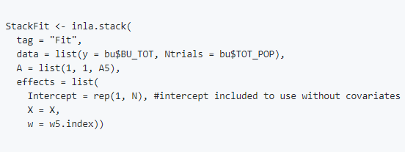
Stack explained
Notes:
Tag to name it.
Include your response data
Include covariates in the “effects” portion
A always incuded like hat as the 1,1,A5 is the intercept, the covartiates and the spatial dependency

Slide 47
Go to the spatial dependency tutorial
We will discuss
Plotting the data
Investigating whether spatial correlation is present
Making the mesh
Including dependency
Predicting from the model
Plotting spatial correlation

Slide 48
How has adding spatial data helped?
Is there still evidence of spatial correlation in the residuals?
What do the credible intervals look like
What if we change our priors?

Slide 49
Useful references
Zuur, Saveliev, Ieno (2017): Beginners guide to spatial, temporal and spatiotemporal models
Highland Statistics: Introduction to spatiotemporal
Blangiardo and Cameletti (2015) Spatial and Spatiotemporal Bayesian Models with R-INLA
R-INLA website: http://www.r-inla.org
Haakon Bakka: https://haakonbakka.bitbucket.io/index.html (lots of SPDE related code)
Bayesian courses – Coursera / Khan Academy (maths behind Bayesian)
Kery and Schaub 2010: Bayesian Population Analysis using WinBugs (linear / glms in BUGS/ JAGS)

Slide 50
General discussion
Notes:
What sort of data do people have?
What about including temporal correlation?

